Slide 1
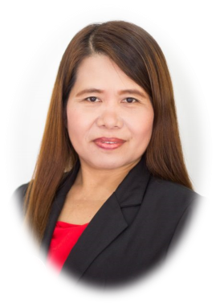
Empowering Educators for Future-Oriented Teaching: Professional Development Initiatives in Cebu Normal University
HELEN B. BOHOLANO, LlB., Ed. D.
Dean, College of Teacher Education
Professor VI
Cebu Normal University

Slide 2
Futures thinking in education
potential directions or aspirations for Cebu Normal University in the future
Some potential aspects that may shape the future of a teacher education institution

Slide 3
potential directions or aspirations for Cebu Normal University in the future
Global Engagement
Interdisciplinary Approach
Technological Advancements
Focus on Sustainable Development

Slide 4
potential directions or aspirations for Cebu Normal University in the future
Community Engagement
Fostering Future-Oriented Skills
Flexible and Lifelong Learning
Research and Innovation
The future of Cebu Normal University will depend on a multitude of factors, including internal and external dynamics, educational policies, funding availability, and societal changes.

Slide 5
The importance of empowering educators for future-oriented teaching through professional development initiatives in Cebu Normal University (CNU).
01
04
Embracing Educational Transformation
Collaboration and Professional Learning Networks
Collaboration and Professional Learning Networks
02
05
Emphasis on Pedagogical Innovation
Continued Professional Development
03
06
Keeping Pace with Technological Advancements
Global Perspectives and Cultural Exchange

Slide 6
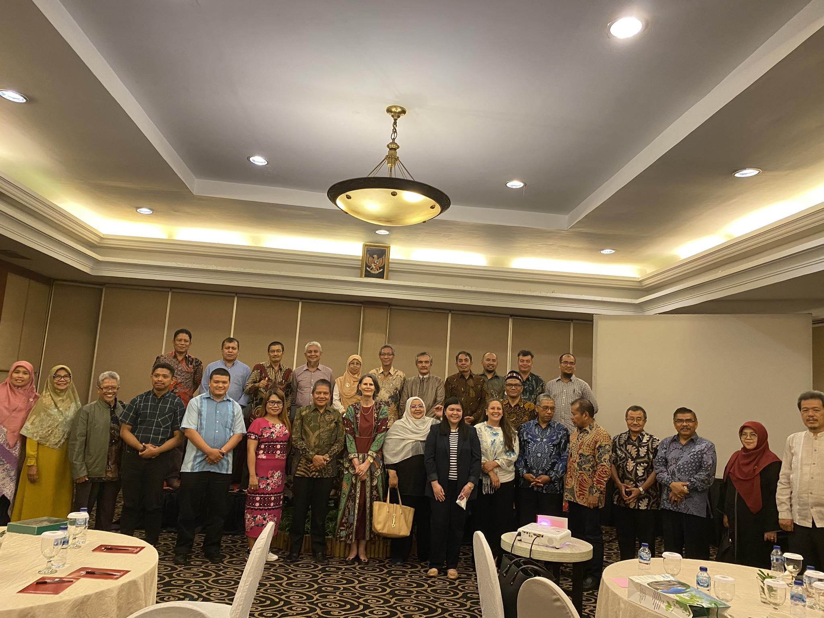
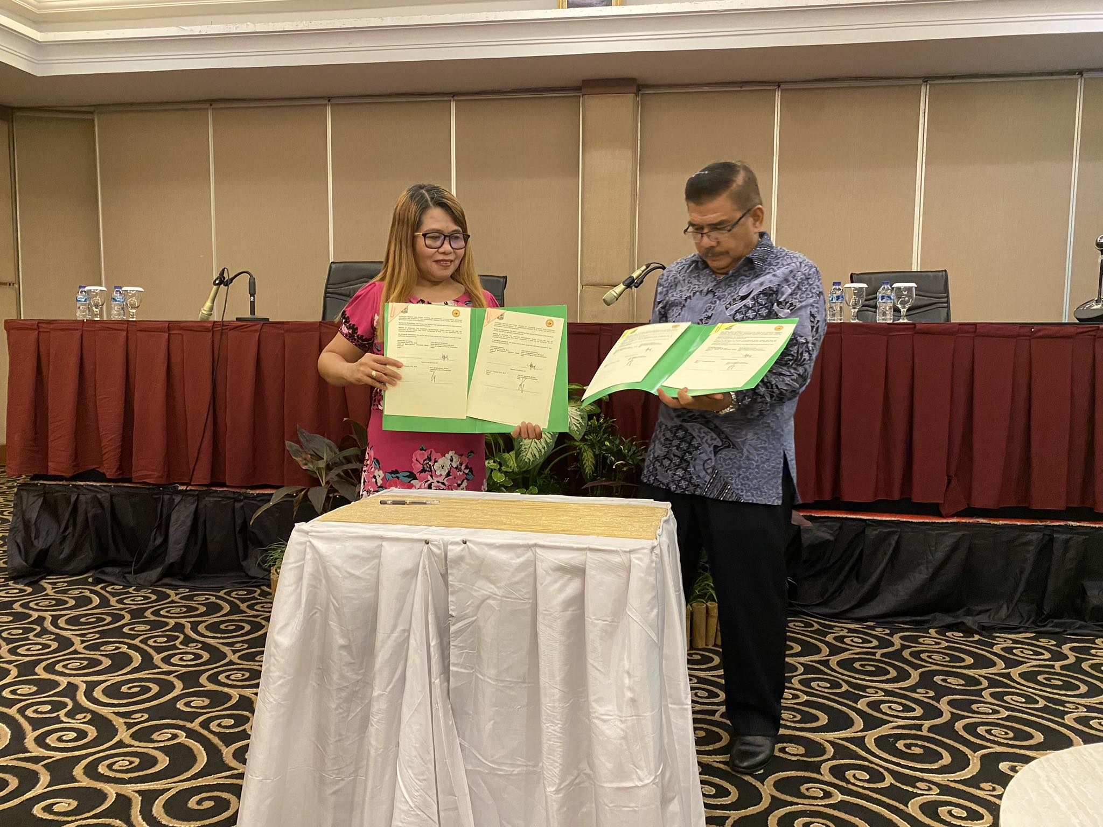

Slide 7
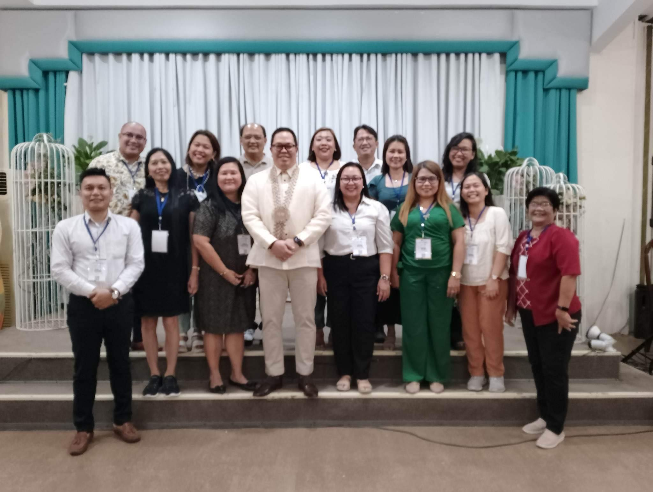
Some potential aspects that may shape the future of a teacher education institution
Customized and Individualized
Pathways
Research-Informed and
Evidence-Based Practices
Systems Thinking and
Policy Advocacy

Slide 8
In a rapidly changing world, futures thinking is the compass that guides us towards educational practices that nurture adaptable, creative, and resilient Filipino learners

